Slide 1

Water Pollution RC Boat
Submitted by:
Name of the Student no 1 : MD.Saiful Hasan Zihn
Section : B
Roll No. : 73
Session : 2016-17
Present Address : Ajimpur,Dhaka
Mobile No (Student) : 01982072124
NU Reg.No : 16502000532
Name of the Student no 2 : MD.Anwar Parvez Bhuiyan
Section : B
Roll No. : 81
Session : 2016-17
Present Address : Jatrabari,Dhaka
Mobile No (Student) : 01827134401
NU Reg.No : 16502000535

Slide 2
Supervised By
Supervisor name
Designation
Institute name

Slide 3
Contents
Introduction
Existing System
Drawback of Existing System
Proposed System
Why It Is Preferable
H/W & S/W Requirements
Methodology
Block Diagram
Circuit Diagram
Application
Advantages
Limitations
Future Scope
Conclusion

Slide 4
Introduction
Smart solutions for water pollution monitoring are gaining importance with advancement in communication technology. The model developed is used for testing water samples and the data uploaded over the Internet are analyzed. The system also provides an alert to a remote user, when there is a deviation of water quality parameters from the pre-defined set of standard values. This device will surf on the water bodies and will provide the required measurement data for the given parameters and will also self-analyses and inform us accordingly.

Slide 5
Existing System
Manual water quality measurement meter.
Smart water quality meter.

Slide 6
Drawbacks of Existing Systems
Hard to measure water quality some specific area.
Need a operator to collect the measurement value.

Slide 7
Proposed System
Develop a RC boat which can be operate through Radio Controller.
Include Bluetooth to see the value and collect it from a distance.
Include all necessary sensors to test the water quality.
Collect measured data on Android App.

Slide 8
Proposed System - Continued
Android Apps
Sending
RC Boat
Receiving

Slide 9
Why It Is Preferable
Easy to operate.
Can be collect data from any portion of water through RC boat.
See Realtime data on android phones.
Can be control boat through android phone and collect data on same phone.
Very low cost.

Slide 10
H/W & S/W Requirements
Hardware
Arduino NANO
pH Sensor
Temperature Sensor
Turbidity Sensor
Bluetooth
Battery
RC Boat
Software
Arduino IDE
Android Apps
C++
Proteus 8

Slide 11
Methodology
We use Proteus Professional 8 for circuit design and PCB design.
Arduino NANO will be used as main brain of the project.
Basic electronics knowledge.
Arduino IDE for hardware level programming.
Android application for operate boat and see measurement value

Slide 12
Block Diagram
Android Apps
Sensors Data
Boat Control System
Charge
Controller
PH
Sensor
Controller
Battery
Turbidity
Sensor
Bluetooth
Temperature
Sensor

Slide 13
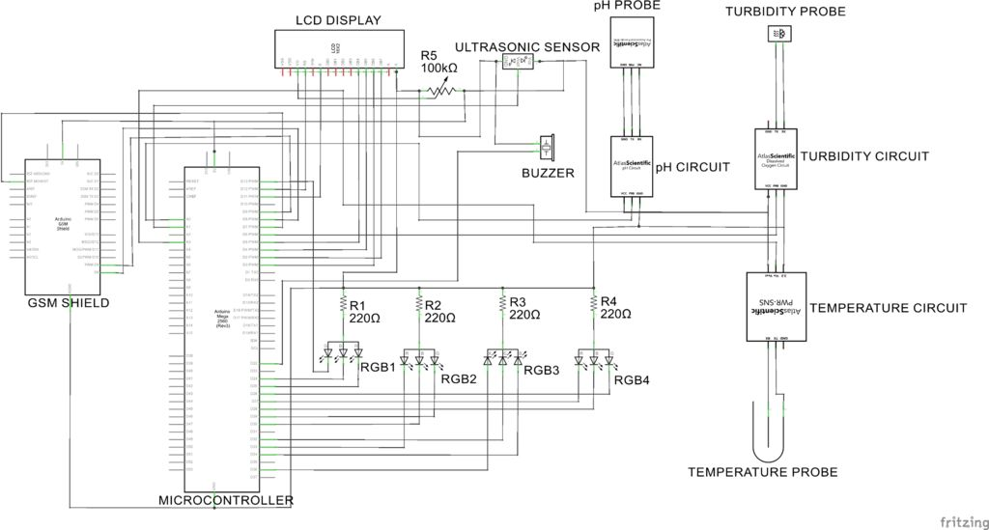
Circuit Diagram

Slide 14
Application
Water quality testing
Sea, River, Cannel temperature measure from different place of water.
Water PH check.
Turbidity sensors measure the amount of light that is scattered by the suspended solids in water.

Slide 15
Advantages
Easy to measure PH, Turbidity and Temperature at a time.
Wirelessly controllable boat.
Can be read data from any place of water.
Can be added more sensor for water quality measurements.

Slide 16
Limitations
There are only 3 sensor that’s why we can measure 3 types of data of water.
Wirelessly connectivity Device is Bluetooth. Which is not for long distance transmission.
There are no GPS System, that’s why we did not locate out boat.

Slide 17
Future Scope
Can be added more sensor like different types of GAS detection sensor and etc.
For long distance transmission can be use RF Transmission module for higher distance.
Can be added GPS. GPS can locate the boat and also able to send the preferred location.
Can be made this automatic system by using GPS, which is location is being predefined and the Boat will automatically go to the place send data and go back home automatically.

Slide 18
Conclusion
Water is increase day by day, without proper monitoring this cannot be stopped. Our monitoring system is for water quality testing, Our Boat can automatically test the water different types of value and data without lab testing and also this data is very important for lab testing.
In near future, Water quality monitoring system will be needed.

